Slide 1

Capstone Project

Slide 2



Personal BACKGROUND
(Name, Past Experience, Qualification, Career Summary)
Name: RITHIKAA V
Past Experience : Fresher
Qualification : BE Computer Science and Engineering
Career Summary :
www.collaberadigital.com

Slide 3


Problem Statement of the Capstone Project
The airport transport system aims to provide a comprehensive solution for managing airport operations, from passenger bookings to flight management. The system is built using a microservices architecture that includes distinct services for user login, admin operations, plane management, airport management, and booking management. Booking microservice is responsible for handling CRUD (Create, Read, Update, Delete) operations related to its domain.

Slide 4
LEARNING FROM THE PROJECT
Key Learnings
Spring Framework: Gained experience in using Spring Boot for developing microservices and employing Spring Data JPA for effective object-relational mapping (ORM), enhancing the ability to build scalable and modular backend applications.
Core & Advanced Java: Strengthened understanding of Java programming by implementing core functionalities and utilizing advanced features to develop robust and efficient backend systems.
AWS Integration: Learned to deploy services on AWS EC2, utilizing cloud resources for scalable applications, and managed service discovery and load balancing through Eureka.
Feign Client for Inter-Service Communication: Mastered the use of Feign Client to create declarative HTTP clients, streamlining inter-service communication within a microservices architecture.
Testing and Quality Assurance: Developed skills in API testing using Postman, writing unit tests with JUnit, and ensuring code quality through static analysis using Sonar-Lint, contributing to reliable and maintainable codebases.

Slide 5
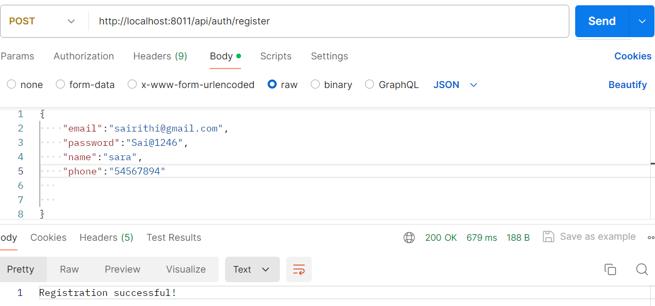
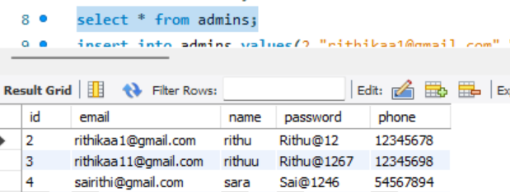
LOGIN AND ADMIN

Slide 6
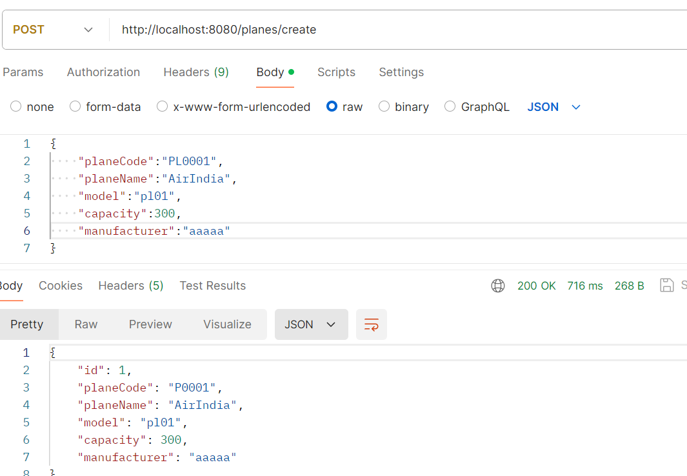
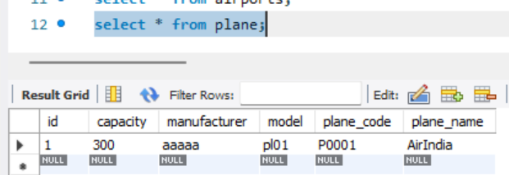
PLANE MICROSERVICE

Slide 7
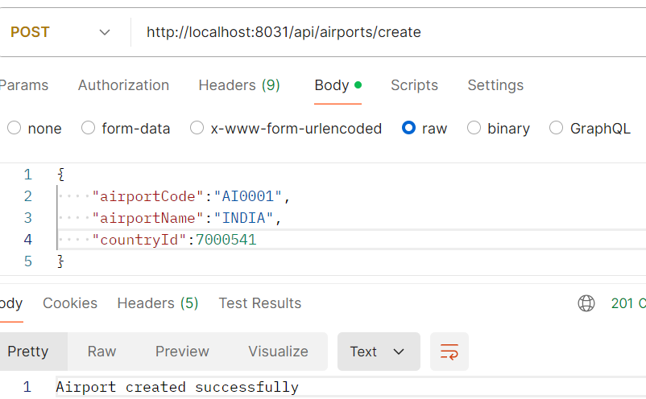
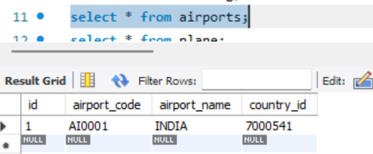
AIRPORT MICROSERVICE

Slide 8
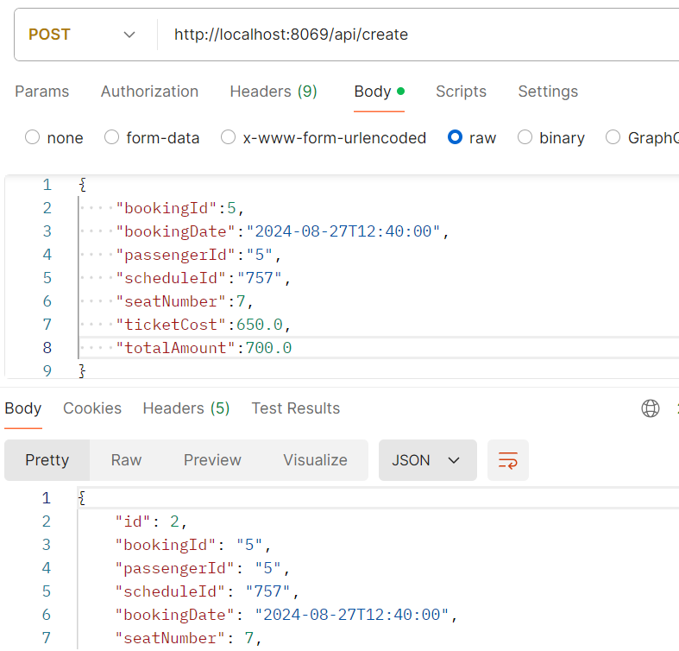
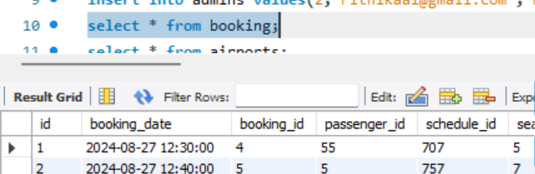
BOOKING MICROSERVICE

Slide 9
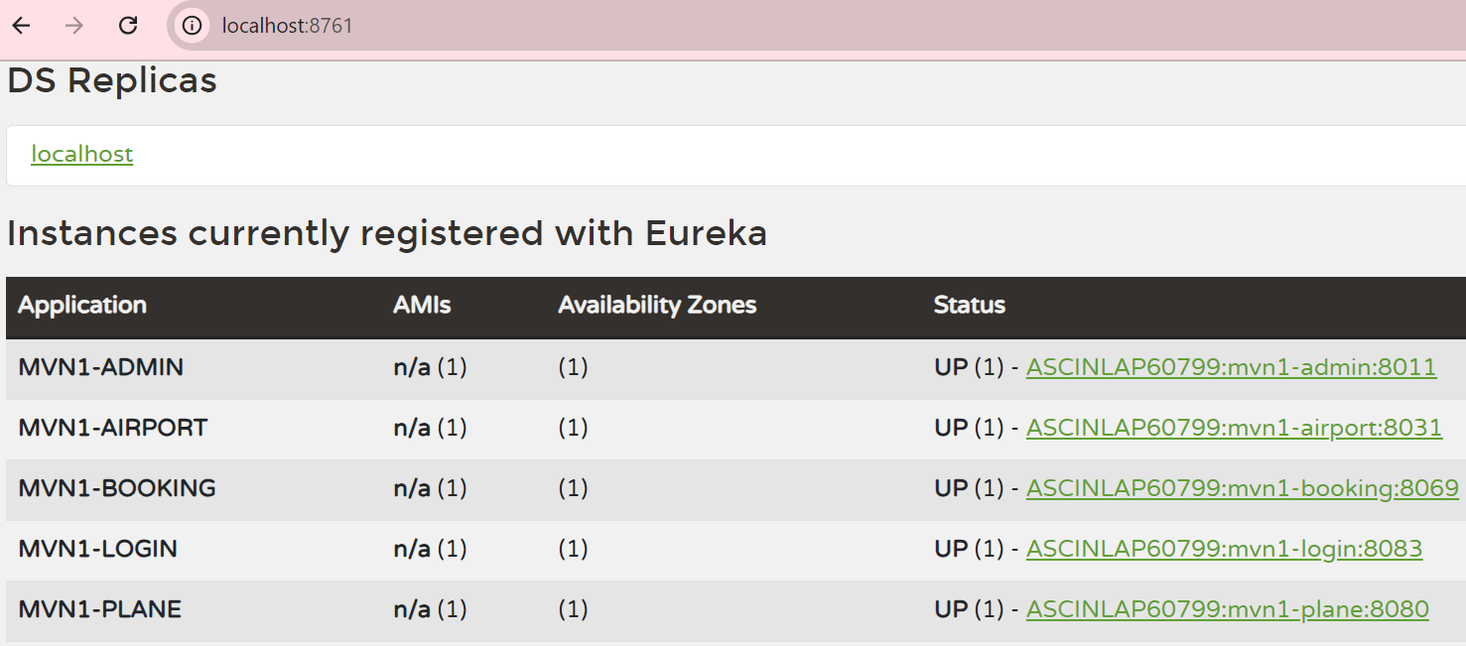
CREATE INSTANCE FOR EUREKA SERVER

Slide 10
The Air Transport System (ATS) project aims to address the key challenges faced by the
aviation industry by providing a comprehensive, scalable, and secure platform for
managing airport operations, aircraft details, and passenger bookings. By leveraging a
microservices architecture with Spring Boot and AWS, ATS ensures efficient data
management, robust security, seamless integration, and enhanced scalability.
Thissolution not only streamlines administrative processes but also minimizes errors and
enhances the overall user experience. Implementing ATS will lead to improved
operational efficiency, increased security, and higher customer satisfaction, positioning
the system as a vital tool for modernizing air transport management.
This project demonstrates the importance of integrating advanced technology with best
practices in software design to solve real-world problems, paving the way for future
innovations in the aviation sector.
Conclusion

Slide 11
Thank You

